Slide 1
Applying to Post-Secondary
And how do I get scholarships?

Slide 2
myPass – why bother?
Grad Checklist (make sure you have Religion 35 too!)
Detailed Academic Report (credits and marks for all high school courses, as well as your Alberta Student Number aka ASN)
Registering to rewrite a diploma exam (hypothetically, obviously)
Fastest way to see diploma exam marks
Only way to order transcripts
Makes it easier to start your ApplyAlberta account (more on that later)

Slide 3
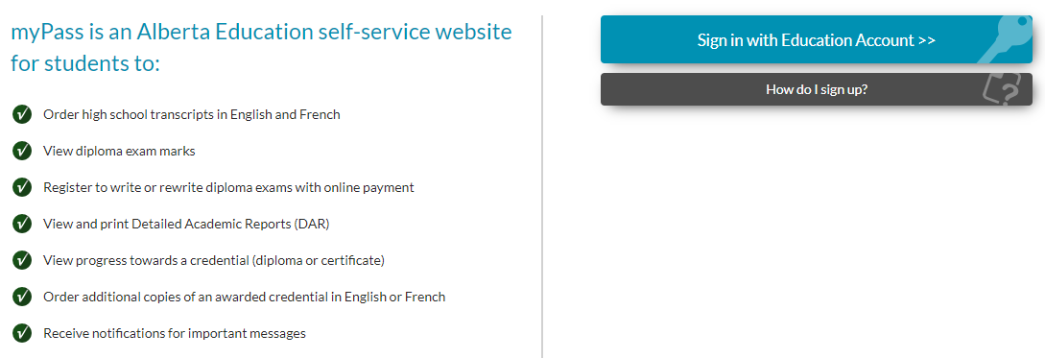
myPass

Slide 4
myPass – how to
See Ms. Mcdiarmid in the main office and she will set you up and/or reset your password – bring your phone with you to get the access code

Slide 5

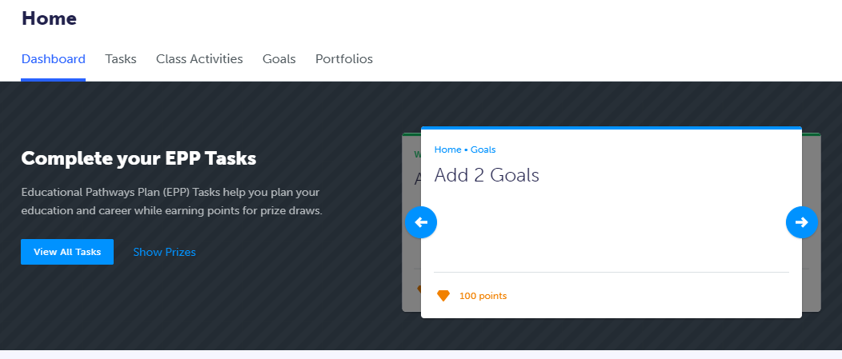
myBlueprint

Slide 6
myBlueprint – why bother?
Can tell you post-secondary programs based on your courses
Can tell you course requirements based on your post-secondary program
Helps estimate your Rutherford Scholarship $$
Personality and Interest surveys that link you to potential careers (under Who Am I?)
Helps with resumes/cover letters
Job search

Slide 7
myBlueprint – how to
See Mr. McLeod in room 206 during Focus to get set up

Slide 8

ALIS

Slide 9
ALIS – why bother?
No account necessary
Occupational profiles - salary expectations, personality traits you should have, work environment expectations, where in Alberta you can get the required training, current demand and future demand, related careers in similar fields you may not know about
Personality tests, next steps, advisors to speak with/message with
How to choose a school, how to pay for your education, how to find a job

Slide 10
ALIS – how to
No account is necessary.
Simply google “alis”

Slide 11
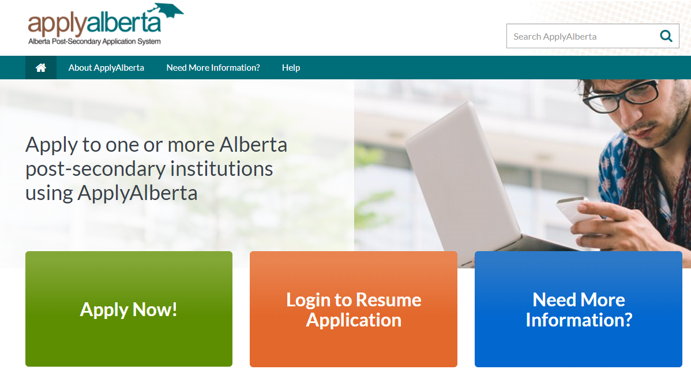
ApplyAlberta

Slide 12
ApplyAlberta – why bother?
All Alberta post-secondary institutions use this website for the application process for all degrees, diplomas, certificates (includes pre-employment trades certificates)
Automatically sends your transcripts to your new school in August after diploma marks are in

Slide 13
ApplyAlberta – how to
Print out your Detailed Academic Report from myPass
Visit www.applyalberta.ca
Create an account using your personal email, not your EDU account
Enter in demographic information
Enter grade history: grade 11 and 12 marks for all core, art, drama, FSL, Instrumental Music, PhysEd, Aboriginal Studies, Yoga, Advanced Acting
IF APPLICABLE: Also enter grade 11 and 12 marks for CTS credits, religion, forensics
Choose school and program (can usually enter first and second choices of program)
Pay application fee
Hit submit!

Slide 14
Applying continued…
Consider applying to approximately 3 programs/institutions (but be mindful of the application fees, because they add up fast)
Check your email and applyalberta account frequently for updates/requests for information (seriously, once every few days)
Create a word doc/google doc/photo album on your phone just for passwords/emails/ID numbers as your email will fill up and they get tough to find later

Slide 15
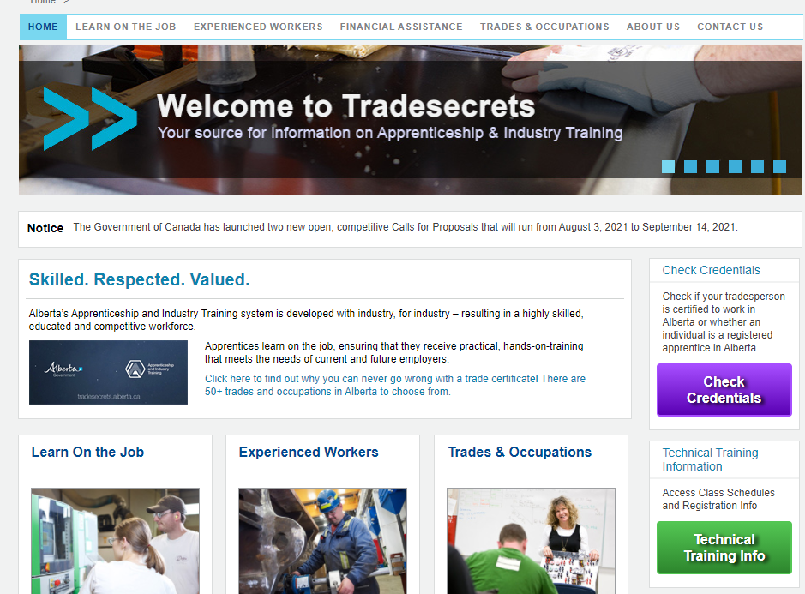
TradeSecrets

Slide 16
Tradesecrets.alberta.ca – why bother?
If you are interested in entering a trade, and/or learning more about which occupations are considered “trades”, this is the site you need to visit.
You can see descriptions of the recognized trades in Alberta
This is where you apply to be an apprentice
This is also where you can learn about scholarships/financial aid for students entering trades

Slide 17
Tradesecrets.alberta.ca – how to
No account necessary if you’re just wanting information!
Create your myPass account first because you’ll need your ASN
Create your myAlberta Digital ID (google the phrase itself)
If you have a journeyperson who has agreed to apprentice you, get their email address
Create your TradeSecrets account and complete the application

Slide 18
Scholarships – why bother?
MONEY

Slide 19
Scholarships – how to
You can sign up for ScholarTree.ca to enter your demographics and they’ll give you scholarship information and updates
You can visit www.sjstudentservices.weebly.com and click on the Scholarship Tab and then “Searching for Scholarships” to find a booklet I’ve linked there. It lists hundreds of scholarships and other places to search.
Most applications are online
It’s free to apply, so apply to as many as you have time for!

Slide 20
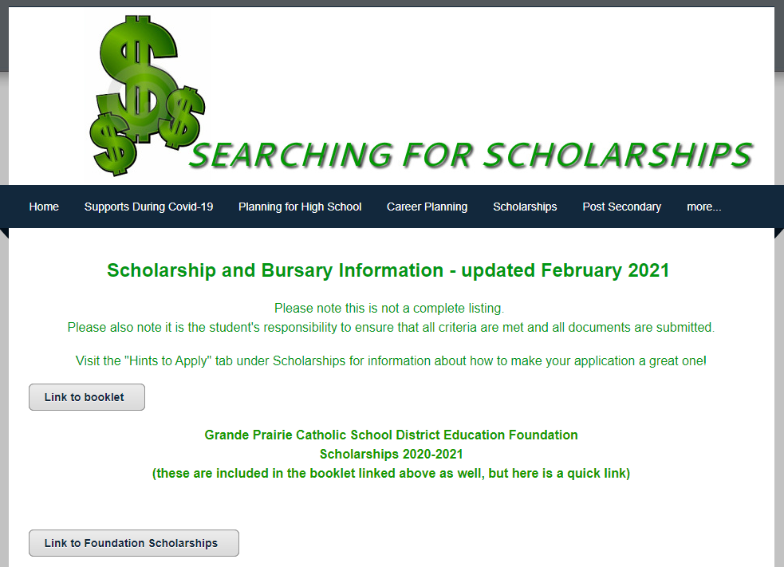
Scholarships - sjstudentservices.weebly.com

Slide 21
Scholarships continued…
Scholarship deadlines are generally based on the size of the candidate pool; national ones have fall deadlines (Oct/Nov), while our local district ones are due May 31.
Some organizations send me paper forms for their scholarships and I leave copies in Student Services. Listen to announcements regarding these in the spring.
Start asking for reference letters now, before things get hectic. Generally, one from a teacher who has known you for at least a year and one from a coach/employer is a great idea, but having both letters be written by teachers is fine as well.
You are in charge of meeting all deadlines and submitting all the required information. I will always assist you if you come ask, but I never chase students.

Slide 22
Also…
Every institution has their own academic advisors and recruiters. They’re great resources. If you can’t find their contact info, come see me or email me. I’ll find it.
I work hard to book in-person visits from institutions as well. U of A is hopefully coming October 29th over the lunch hour in our library to present their programs and opportunities. But I am waiting for confirmation
You can always come see me or email me questions.

Slide 23
Key Points for Grade 12s
Post-secondary institutions start accepting applications October 1 for the next fall.
You would be applying for Fall 2022, NOT Winter 2022 (that means this coming January).
Deadlines for programs vary and some programs do fill up. Try to apply for at least one school by the end of November.
If you’re taking a gap year, make a plan for that year so it’s not wasted.

Slide 24
Key Points continued
I can help you sort out your applyalberta.ca account as well as requests for documentation. I can also help you apply to schools outside Alberta.
I can also help you pick programs. Mr. MacPherson is good at this too, especially for trades programs.
You are not expected to know right this second what you want to do with the rest of your life. My goal is to help each of you figure out at least one “possible next step” you’re excited about by the end of semester 1.
Remember to breathe!

Slide 25
Seriously…
You’ve got this
No question is stupid
I love having these conversations so please come see me

