Slide 1

Welcome to St. Joe's online course selection
This Powerschool portal will be available from March 21 to April 12, 2022. Once this portal closes, course selections can still be changed but must be completed with the school counselor.

Slide 2

The Process
April: Students pick their courses
April/May: Timetables are built and double-checked
June: Timetables are given out to students

Slide 3
Detailed Academic Report
Your report contains important information:
Your powerschool login info (see attached page)
Historical grades and credits
Note: you do not require this report to do online course selection. You will receive this report when you attend your scheduled session with your class, but you can begin without it.
This has your log-in information so please do not leave this paper laying around. Keep it with you so you can log in later to show your parents/guardians.

Slide 4
Students Intending to Take Courses at St. John Bosco Next Year
For the purposes of the online form, you’ll be selecting courses only at St. Joe’s.
Registrations for courses at St. John Bosco will be done separately and on an individual basis.
Registrations will begin at a later date.

Slide 5

Important info re: total credits
St. Joe's students must have earned:
A minimum of 20 credits in grade 10 to be considered a grade 11 (otherwise you will be rolled back to grade 10)
A minimum of 60 credits to be considered a grade 12 (and on the grad list). Students with fewer than 60 credits as they enter the school year will be rolled back to grade 11 and may not graduate until the following year.

Slide 6


TOTAL NUMBER OF CREDITS REQUIRED
Students in Alberta require 100 credits to earn their high school diploma

Slide 7


For Specific Alberta high school diploma requirements see information near the end of this presentation

Slide 8

Full course loads
Grade 9, 10, and 11 students are generally not allowed spares.
Grade 12 students must enroll in at least 25 credits.

Slide 9

New Courses for 2018-2019!
LEGAL STUDIES 10/20/30
This exciting new course will let you explore the world of law.
Offered using CTS credits, so you’ll earn credits as you go.
While this course isn’t required by any post-secondary program, it is a great course to try if you’re considering Law, Criminal Justice, Law Enforcement, or Social Justice.

Slide 10


CHORAL MUSIC 10/20/30
For those of you who love to sing, now is your chance to take lessons during your school day.
Similar to Drama and Art, this class is worth 5 credits at each level.
You can request to take the course all year by selecting 2 consecutive levels. (Ex. 10 and 20)
This class will also offer the opportunity to participate in the celebration/mass choir year round.

Slide 11


New Courses for 2017-2018
Yoga 15/25/35
Students will learn about and use yoga and meditative practices, to help balance out a busy life and stress. It will also help students develop resilience and inner strength. Students who successfully complete this course will earn 5 credits.

Slide 12

TECHNOLOGY OPEN STUDIES 10/20/30
(replacing Photo, Robotics, & Computers courses)
This exciting new course allows students to take credits from a wide variety of areas, such as:
Photo, Robotics, Design, Networking, Video, Programming, Finance, Marketing, and more!
By combining our former courses of Photo, Computers, and Robotics, you get to customize this course for yourself.
You can select it once on the form, but if you also request it on the RAC form you can take this course TWO OR THREE times in a year!

Slide 13


Aboriginal Studies 30 (5 cr)
This course allows students who successfully completed Aboriginal Studies 10 and 20 to continue their learning in this area.
It is acceptable by some post-secondary institutions to satisfy entrance requirements to some programs.
All Aboriginal Studies courses are now offered for 5 credits each.

Slide 14

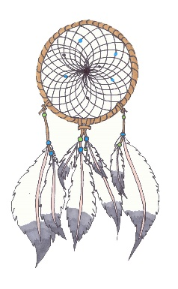
New Courses for 2016-2017:
Outdoor Education 10/20/30
Students will explore a variety of outdoor and wildlife related skills and topics, including shelters, safety, and the environment.
Aboriginal Studies 10/20 (6cr)
Students will explore the culture and history of aboriginal peoples.

Slide 15

ADVANCED PLACEMENT COURSES
Biology 30 AP (Advanced Placement) (8 credit full year course)
English Literature and English 30-1AP (8 credit full year course)
European History/Social Studies 30 AP (8 credit full year course)
Math 31AP (Calculus) (8 credit full year course)

Slide 16

Athletic Development Courses:
Athletic Development 10, 20 and 30 are classes designed for students who wish to excel in their sport.
Athletic Development 10 is offered during the school day (two semesters: 3 credits in one semester and 5 credits in the other). The course fee is $300 (subject to change). Student who take Athletic Dev. 10 will meet the grad requirement for PE 10.
Athletic Development 20 and 30 Students earn between 5 and 7 credits. The AD 20 course fee is $300 and the AD 30 course fee is $300 (subject to change).

Slide 17
How to Apply
In order to be accepted into the Athletic Development Program, you must do 3 things:
1. Select the course on the online form.
2. Visit sportsacademy.gpcsd.ca to complete the application forms and submit them to the main office or Mr. Prichard directly by April 14, 2022

Slide 18

Prerequisites and the online form
The online form will only allow students to select courses if they have the prerequisite course and mark.
Look at the prerequisite charts to determine this.
This does not apply to courses within your pod/college. You will be automatically enrolled into those.

Slide 19

Prerequisites for students entering grade 10
Because you’re heading into pods next year, your core subjects are chosen for you. It’s important, however, to be aware that there are different levels of courses as you move through the next few years of school.
If you’re not able to be successful in the top academic core subjects, your teachers will work with you and your parents to determine the best solution.

Slide 20

Prerequisites for students entering grade 10
EX) If you’re currently at 40% or higher in English 9, or 65% or higher in a KAE English 9, you’ll be selecting English 10-1.
EX) If you’re currently lower than 40% in English 9, or lower than 65% in KAE English 9, you’ll be selecting KAE English 10-4

Slide 21
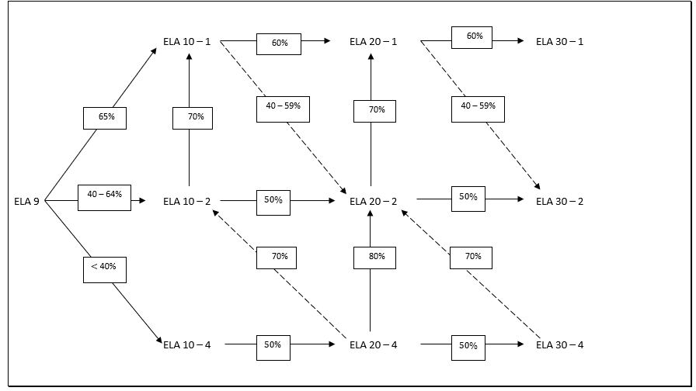
English Prerequisite Flowchart

Slide 22
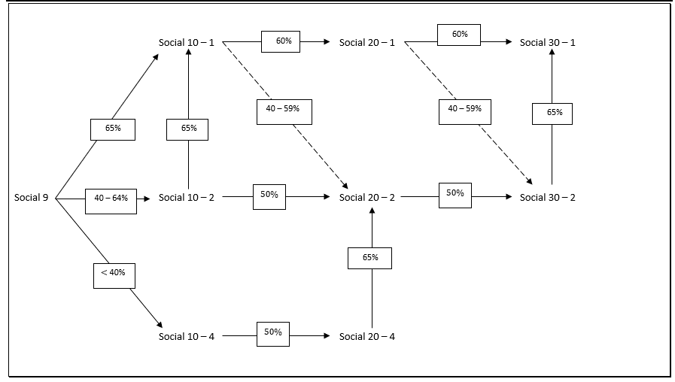
Social Studies Prerequisite Flowchart

Slide 23
Mathematics prerequisite flowchart NOTES:
It is important to note that both Math -1 and Math -2 are academic Math courses.
Alberta universities will accept Math 30-2 for many programs: Ex: Bachelor of Arts (for most majors including Psychology), Bachelor of Education (as long as you don’t want to teach Math or Sciences), Bachelor of Science in Nursing.
Recommendation: consider taking Math 30-2 and then Math 30-1 (esp. if Math 20-1 mark is under 65%) if you think you will need Math 30-1 for the postsecondary program you are interested in.

Slide 24


Math 31
Math 31 (one semester course) is a Calculus course and it requires Math 30-1 as its prerequisite or co-requisite.
Math 31 is required for all university Bachelor of Engineering programs and recommended for those entering university programs in Math, Sciences, and Business/Commerce.

Slide 25

More Math info for students entering grade 11
If you wish to take Math 31 or Math 31AP in grade 12, you will request to be in both Math 20-1 and Math 30-1 in grade 11.
It is possible to take Math 30-1 concurrently with Math 31, but it is not recommended as we have not seen a consistent history of success with this.

Slide 26

MATH and TRADES
The Math -3 stream is recommended for the majority of trades.
Note: There are a few trades and technical programs that still require Math10C, -1 or -2.
Refer to the WEBSITE listed on the next slide for specific requirements for trades in Alberta, or the handout provided

Slide 27
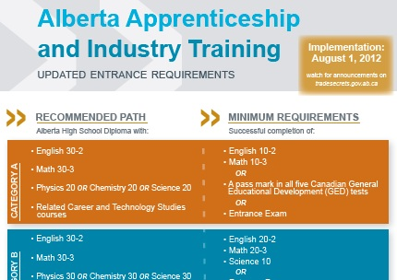
Go to: http://tradesecrets.alberta.ca to look up the high school requirements for the trades

Slide 28
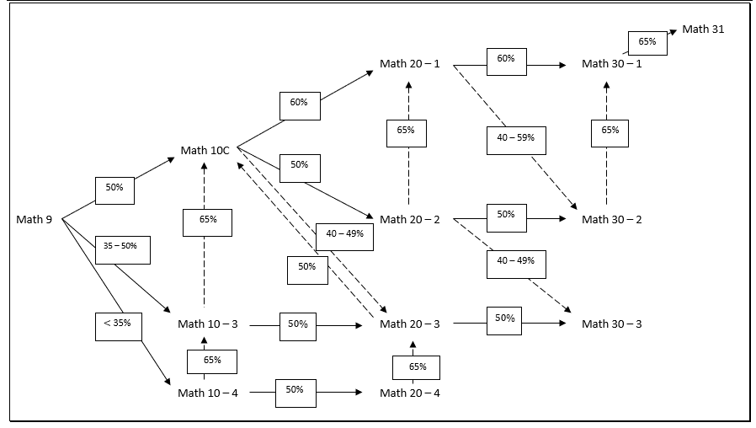
Mathematics Prerequisite flowchart

Slide 29

Science Courses in grades 11/12
Chemistry 20, and Physics 20 are very academic courses, with a significant amount of mathematical content incorporated into the science.
While the form requires only a strong mark in Science 10, we recommend that students take their math marks into consideration when choosing these courses.

Slide 30


Science Courses continued…
Science 20 and 30 are also academic sciences and should be considered by those students looking at any post-secondary education.
They are recommended for most trades.
Several university/college programs accept Science 30 as an entrance requirement and/or as part of a scholarship average calculation.

Slide 31
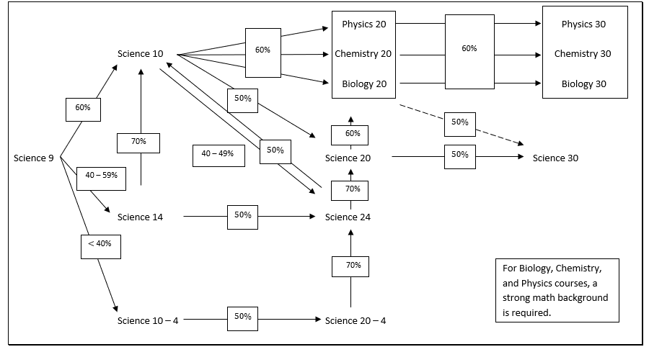
Science prerequisite flowchart

Slide 32
Knowledge & Employability Courses
KAE courses are still offered, but do not appear on the online form as students must have parent permission to join them.
To request any KAE course, please select “request a course” on the online form and then complete the “request a course” paper form by hand and submit it.
These courses are intended for students who struggle significantly in their academics and may struggle to complete the requirements of an Alberta High School Diploma.

Slide 33
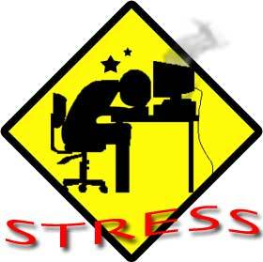
CAUTION: HEAVY COURSE LOADS CAN BE STRESSFUL
Students should be careful when selecting additional core courses.
Be aware of your total course load and make sure you have the time to dedicate to it. Take into consideration academic load and also extracurricular activities, family responsibilities and/or part time jobs.

Slide 34


Physical Education 10 and CALM 20 (Career and Life Management) Requirements:
All students must pass (50%) in both PhysEd 10 and CALM 20 to qualify for their Alberta High School Diploma.
Students who pass Athletic Development 10 will be awarded PhysEd 10 credits.

Slide 35

Religious Studies requirements:
In order to graduate from St. Joe's, students must enroll in and pass the following Religious Studies courses:
Religious Studies 15 (RS 15) (3 credits)
Religious Studies 25 (RS 25) (3 credits) AND Religious Studies 35 (RS 35) (3 credits)
RS 25 and 35 courses will be taken in grade 11
Grade 12 students will not be required to take a Religion class UNLESS they did not pass both RS 25 and RS 35 in grade 11.

Slide 36


RELIGIOUS STUDIES REQUIREMENTS continued
Students who come to St. Joe's from another high school are only expected to complete the Religion classes that correspond to their grade.
For example: If a student enters St. Joe's in grade 11, they will be required to complete RS 25 and 35. If a student enters in grade 12, they will be required to complete RS 35. They may choose to take RS 25 as well.

Slide 37

Religion for grade 11 students who wish to enroll in THREE additional science courses and are in French 20/Art 20/Drama 20:
Ex: Chemistry 20, Physics 20, Chemistry 30
You may delay taking RS 25/RS 35 in your grade 11 year
However, you will be required to take RS 25/RS 35 in your grade 12 year.
Note: Grade 11 students are not guaranteed spots in grade 12 courses.

Slide 38
Alberta High School Diploma
All students require the following courses to earn an Alberta High School Diploma:
Grade 12 English course
Grade 12 Social Studies course
PLUS: 10 more grade 12 credits (can be core courses in Math or Sciences OR credits in Work Experience 35, OR 30 level options like Art, Drama, CTS modules, AthDev, French, etc. )
Grade 11 Math course
Grade 11 Science course PLUS
(more requirements on next slide)

Slide 39

All students must also earn at least 10 credits in any combination of the following courses:
Art Drama French Cosmetology
AthDev 20/30 PhysEd 20/30 Foods
Fabrication Mechanics
Yoga Technology Open Studies
Band Fashion Construction Paleontology Health Science

Slide 40

New Course for 2022-2023!
Aboriginal Studies 10/20
(3 credits each, can be selected individually or together for one block)
Students will learn about the culture, the history, and the geography of Indigenous peoples.
*availability will depend on staffing and # of requests

Slide 41
Special note on Aboriginal Studies
Aboriginal Studies 10/20/30 do NOT count towards your Option Credit requirement but do count towards your total credit count.
Aboriginal Studies 10/20 are taught together in one block for 6 credits, but gr10 students can choose only the 10-level if they wish.
Aboriginal Studies 30 is optional and considered by many post-secondary programs as an academic core subject. And there is no diploma exam at the end of this course.

Slide 42

New Course for 2022-2023!
Paleontology 15 (3 credits)
Students will learn about past biodiversity, Earth history, and life on Earth.
*availability will depend on staffing and # of requests

Slide 43

Additional AB High School Diploma requirements:
Students must also earn credits in PhysEd 10 and CALM 20.
AND
Students must pass RS 15, 25, and 35 in order to graduate from St. Joe’s.

Slide 44
Completing the online course selection form:
Login to powerschool using your student password (go to www.stjoseph.gpcsd.ca and use the student portal)
Click on the “Class Registration” button
Note that this will be available from March 21 to April 12, 2022
Read the instructions of each section of the form. Open each section by clicking on the “pencil icon” on the right-hand side. Select the course or courses and press “OKAY” to close the section.

Slide 45
When to use Request a Course
Use the “Request a Course” in the following situations:
1. If you want to take a course “out of grade” (EX: Art 30 in grade 11, repeat Science 20 in grade 12, etc).
NOTE: Grade 11 students are not guaranteed a spot in grade 12 courses. Grade 10 students are not guaranteed a spot in grade 11 courses.

Slide 46
“Request a course” info continued…
2. If you want to take a certain course but you do not have the prerequisite course or mark. Select “Request a Course” and explain in detail (on the paper form) why you should be allowed to take the course. Not all requests will be allowed. Clearly state the reason you should be allowed to enroll in the course.
3. If you’re wishing to take more than one section of an option. (EX: more than one section of Technology Open Studies)

Slide 47
REQUEST A COURSE…CONTINUED
IF YOU SELECT “REQUEST A COURSE” ON THE ONLINE FORM, YOU MUST ALSO FILL IN A PAPER FORM.
AGAIN, BE SURE TO EXPLAIN IN DETAIL WHICH SPECIFIC COURSE YOU WISH TO TAKE (EX: Art 20) and EXPLAIN WHY YOU NEED THIS COURSE AND WHY YOU SHOULD BE ALLOWED TO TAKE IT.

Slide 48
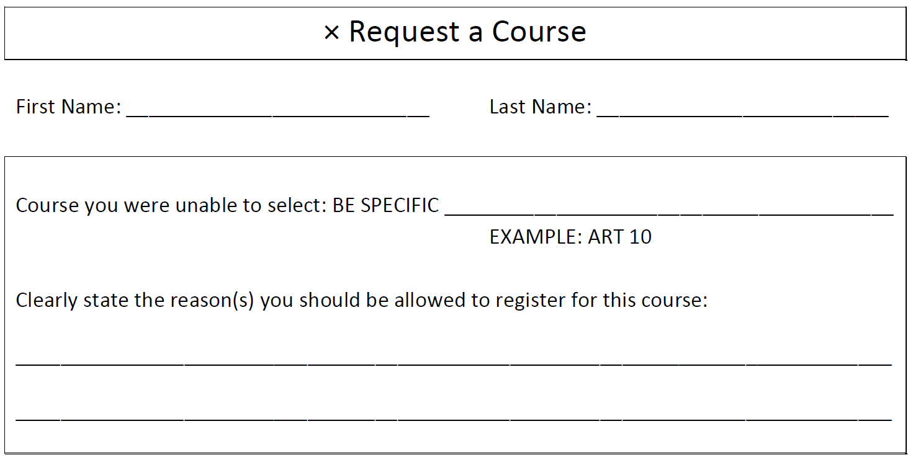
EXAMPLE OF THE REQUEST A COURSE FORM

Slide 49



Choose your options carefully
We generally cannot accommodate changes to options classes so choose options carefully. Do not choose options just to be with friends!

Slide 50
3-credit options vs 5-credit options
Grade 10 students take 3-credit options so they can experience more of them.
But there are a few exceptions that run only as 5-credits:
Drama 10
French 10
Athletic Development 10
Even if you’re taking these exceptions, you’ll need to pick at least one 3-credit option to complete your timetable.

Slide 51


Band classes:
Band will continue to be offered to St. Joe’s and JPII students in the evenings.
Band does not affect a student’s daytime timetable.
If you want Band, select it on the form and then please complete a “request a course” form and state your instrument(s).

Slide 52

Theatre Classes
Students can choose to take Drama 10/20/30 at St. Joe’s, but also have the option to take Advanced Acting/Touring Theatre at JPII.
This is a 5-credit course that is taught after-hours, so it will not affect your daytime timetable.
This can be selected in the “after-hours” section of this form by clicking “xAttendDrama”

Slide 53


“Complete this section last”
The courses you select in this Alternate section MUST BE DIFFERENT than the ones you chose in the other sections of this form.
Alternate options are the “back up plan” in case your favourite options do not fit in your timetable.

Slide 54

Final steps:
Once you have opened each section of the online form and selected your courses, you should see a green ✓ beside each section.
If you have a red ! it means you have not completed the section correctly.

Slide 55

Very important!
Once you have finished each section, click SUBMIT to save your course selections. DO NOT LOG OUT (in case you have to go back and make changes).
Take a pen/pencil and complete the Option Preference form.
Staple any “Request a Course” form(s) to this printout and hand it in to a school counselor or teacher.
Once a school counselor checks it over, you may log out.

Slide 56

Final notes:
You may still make changes to your online course selection form (until April 12, 2022).
We also encourage you to Login in and click on Class Registration to show your parents/guardians the courses you selected.
Make any changes you wish.
Be sure to click on the Submit button when you are finished looking and/or making changes.
If you make any changes to your options, please see Ms. Martin or email pamelamartin@gpcsd.ca to update your Option Preference form.

Slide 57
Go to: Stjoseph.gpcsd.ca
Click on “PowerSchool” tab
Click on “PowerSchool”
Log in
Click on “Class Registration”

